Slide 1
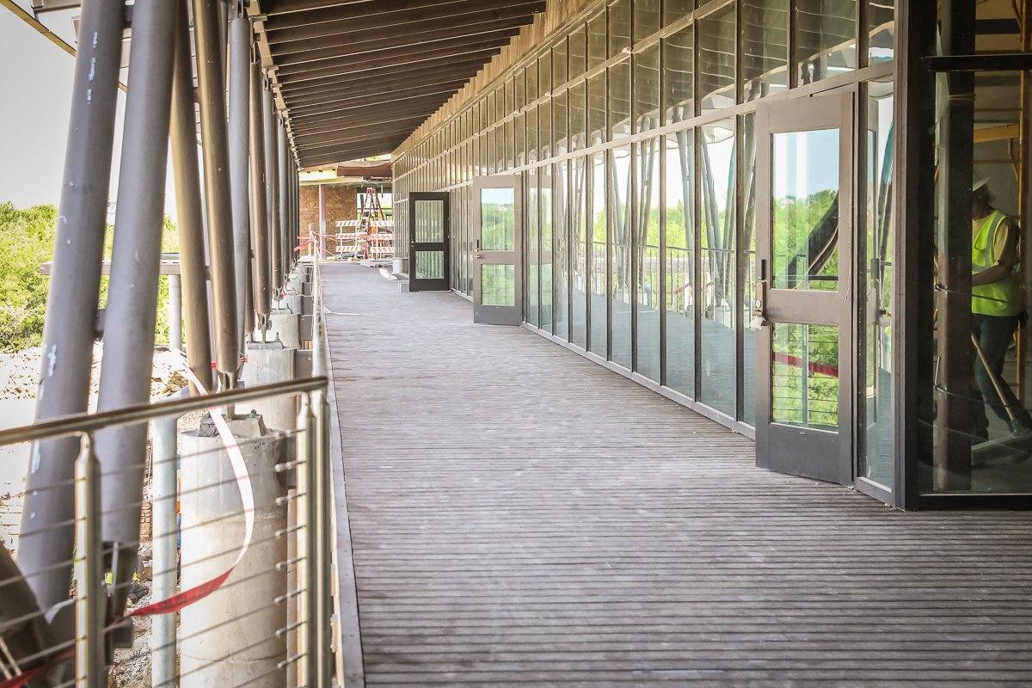
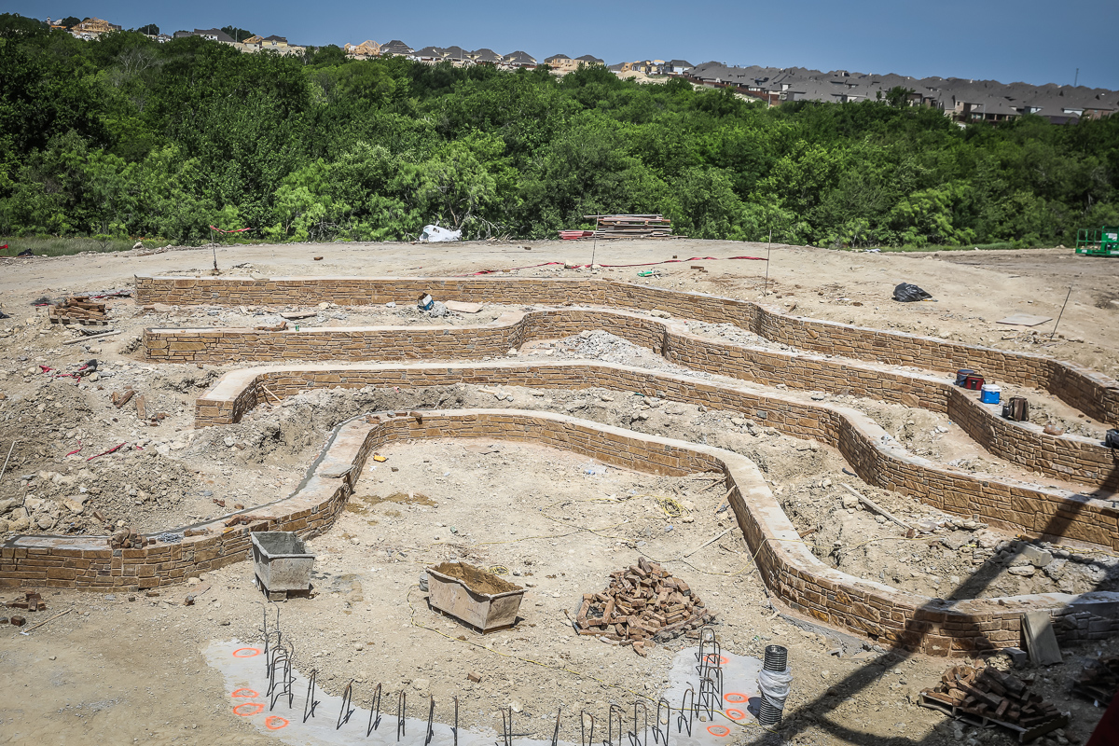
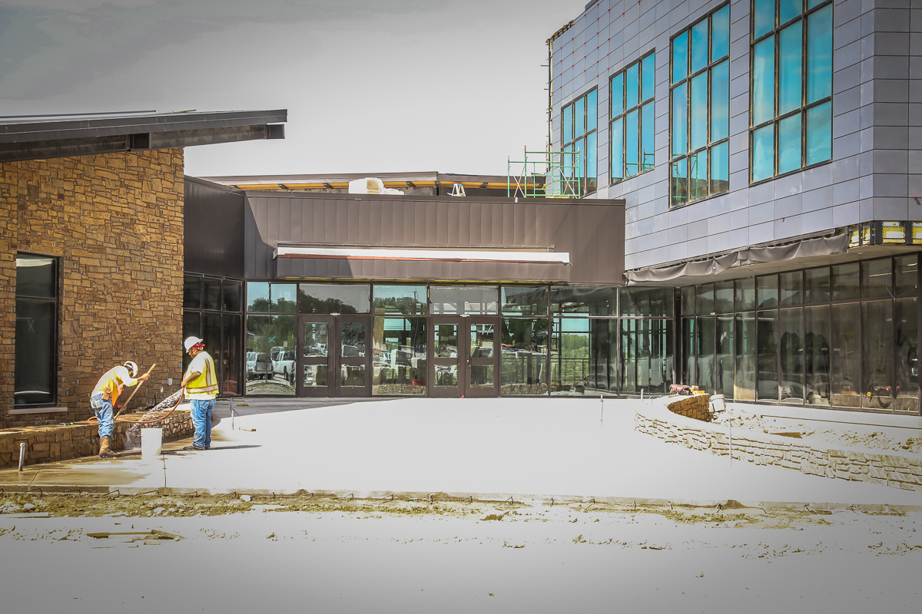
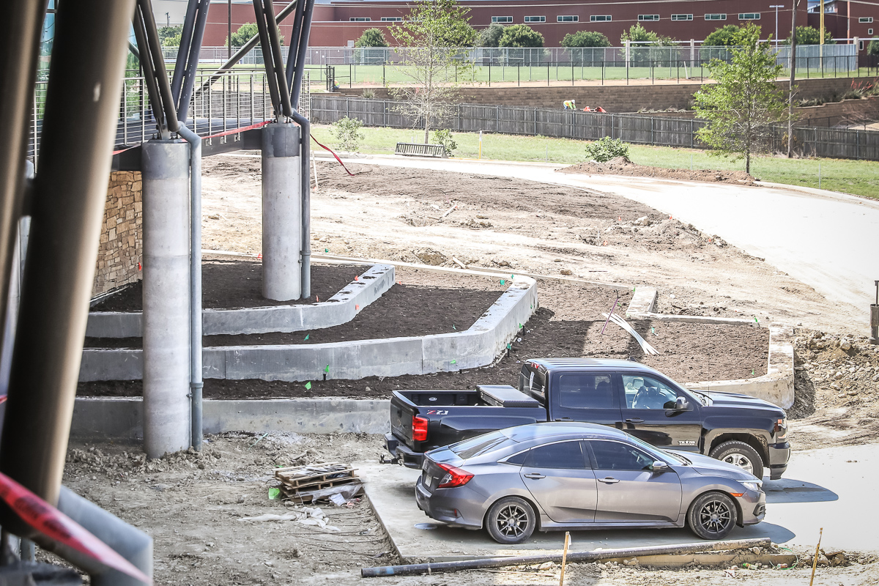
ADMINISTRATION BUILDING
Balcony walkway is completed in Areas C, B, and most of A.
Work continues on the retaining wall and planting beds. Entrance in Area C is progressing.

Slide 2
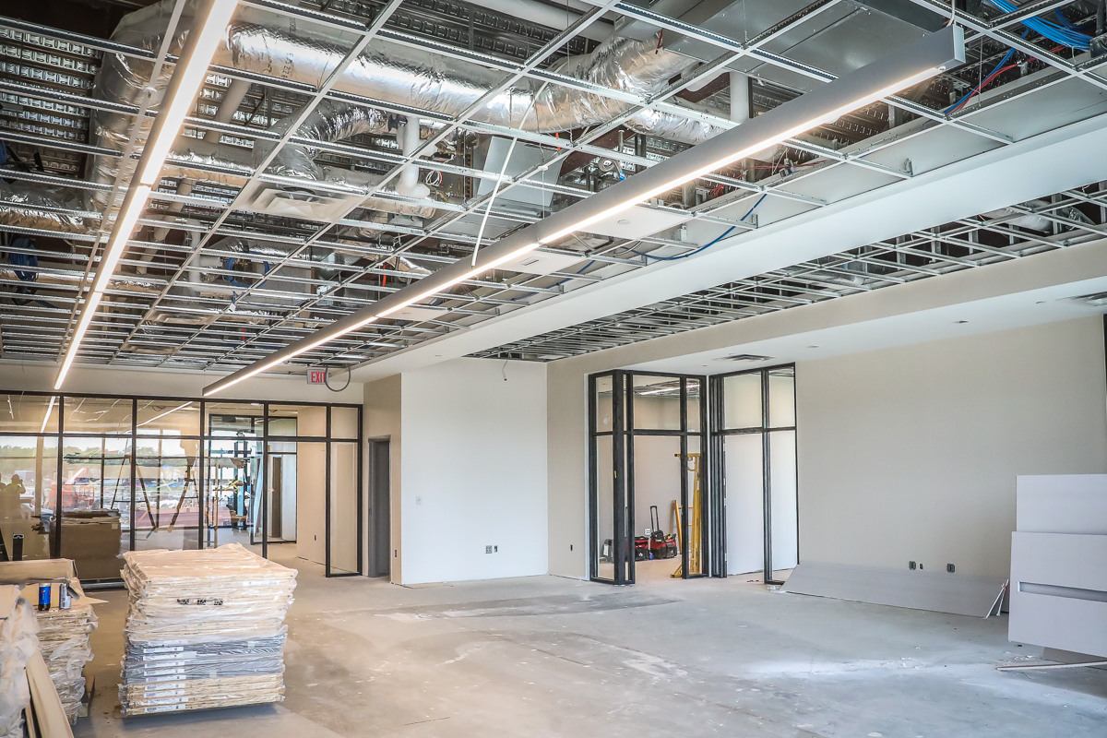
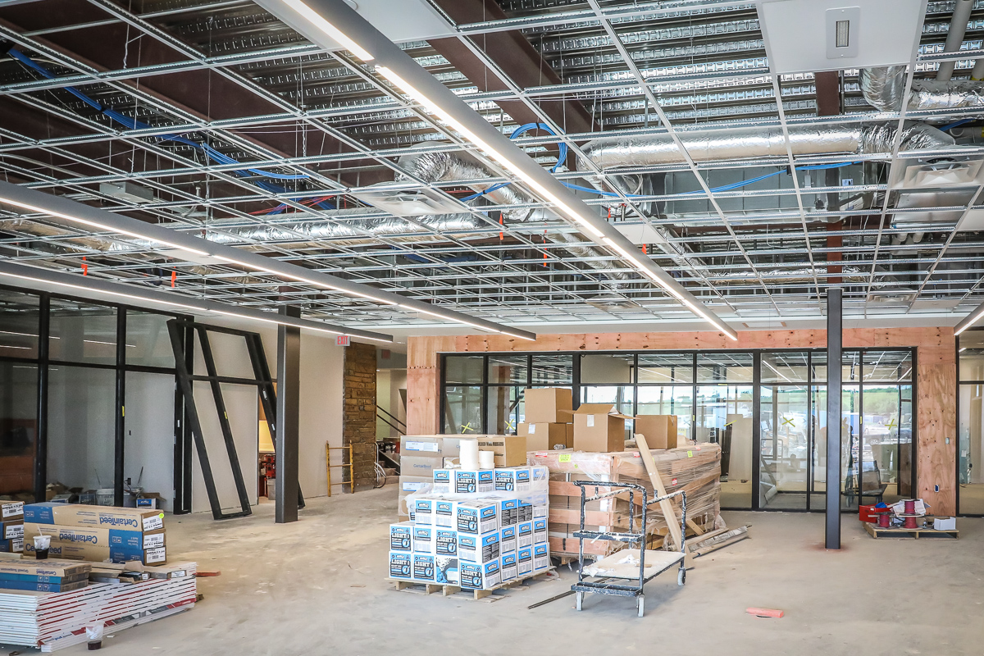
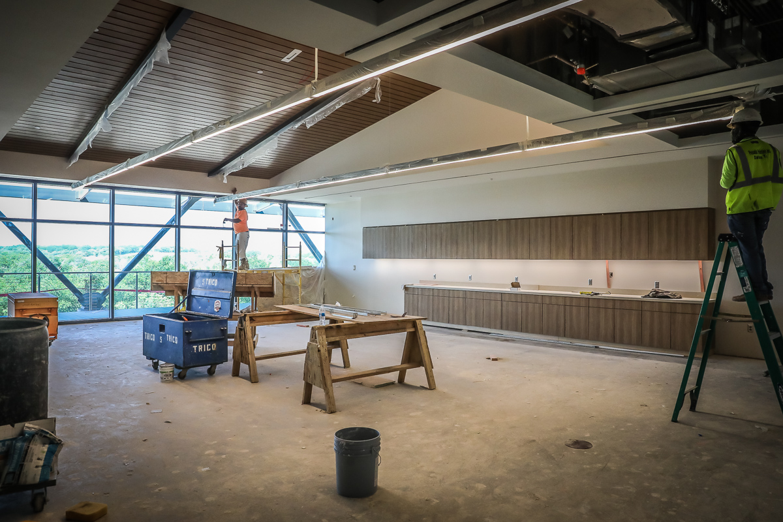
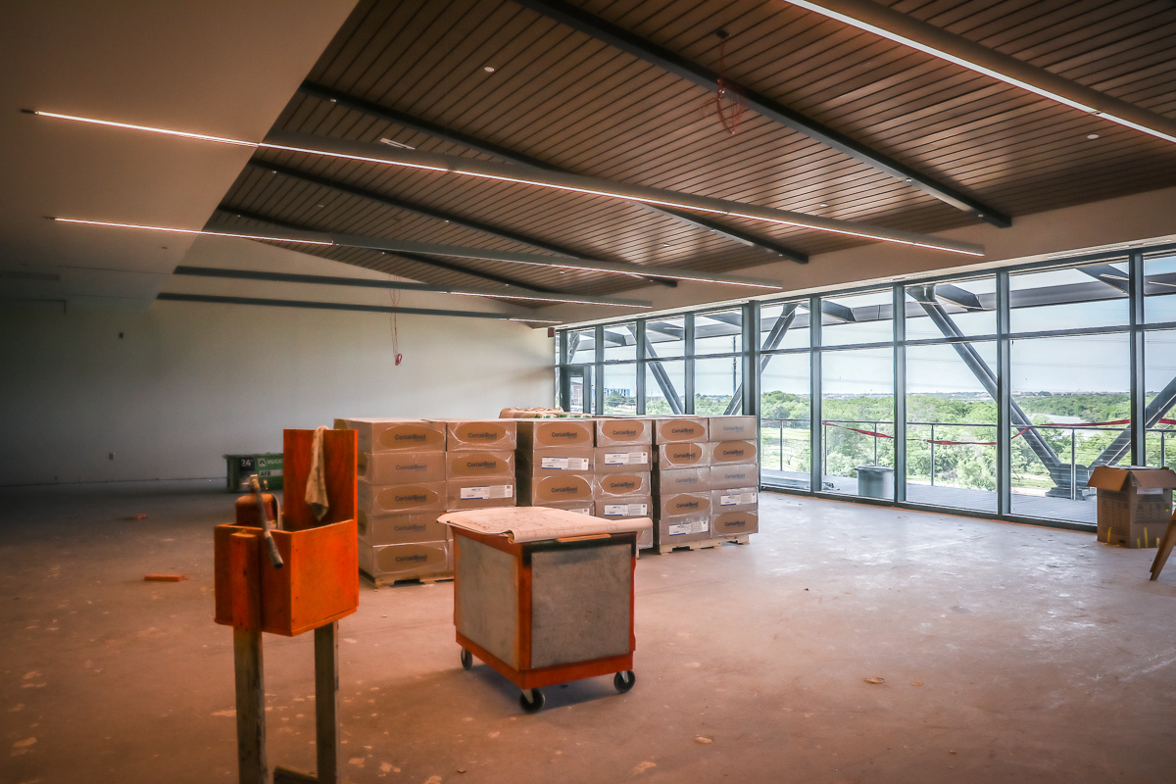
Work progresses on MEP, data, lighting, and ceilings on the first floor of Area B.

Slide 3
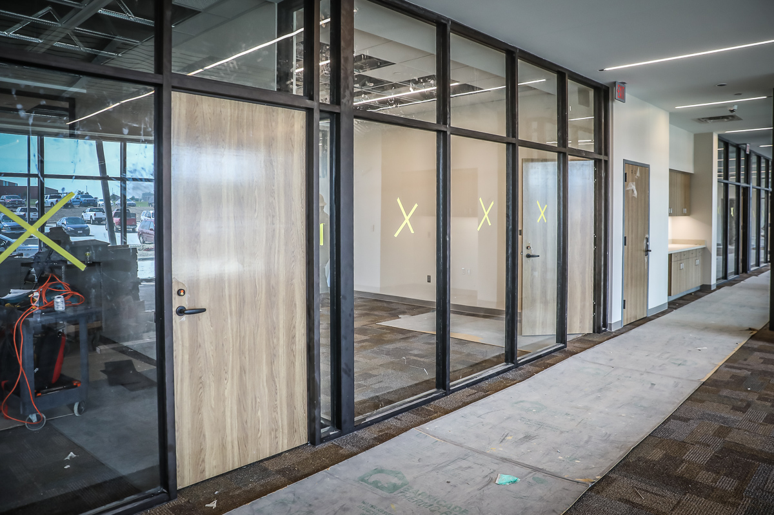
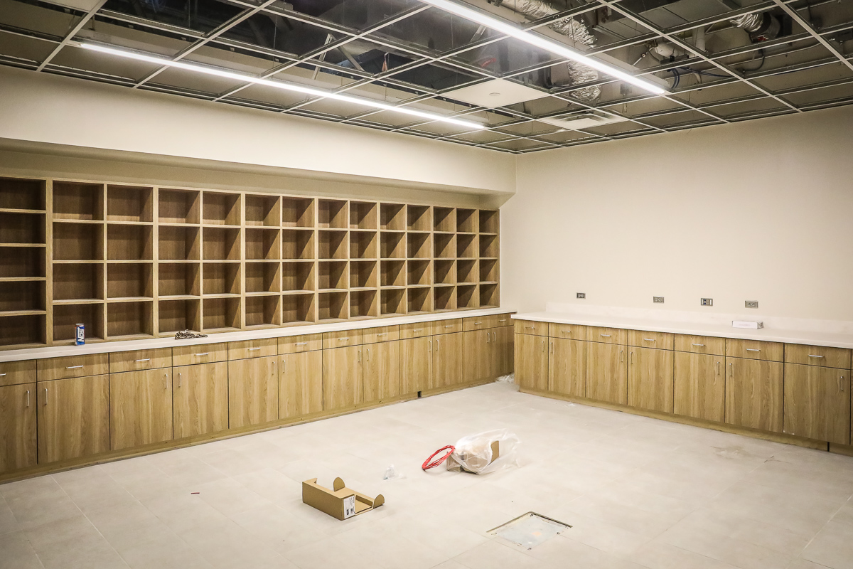
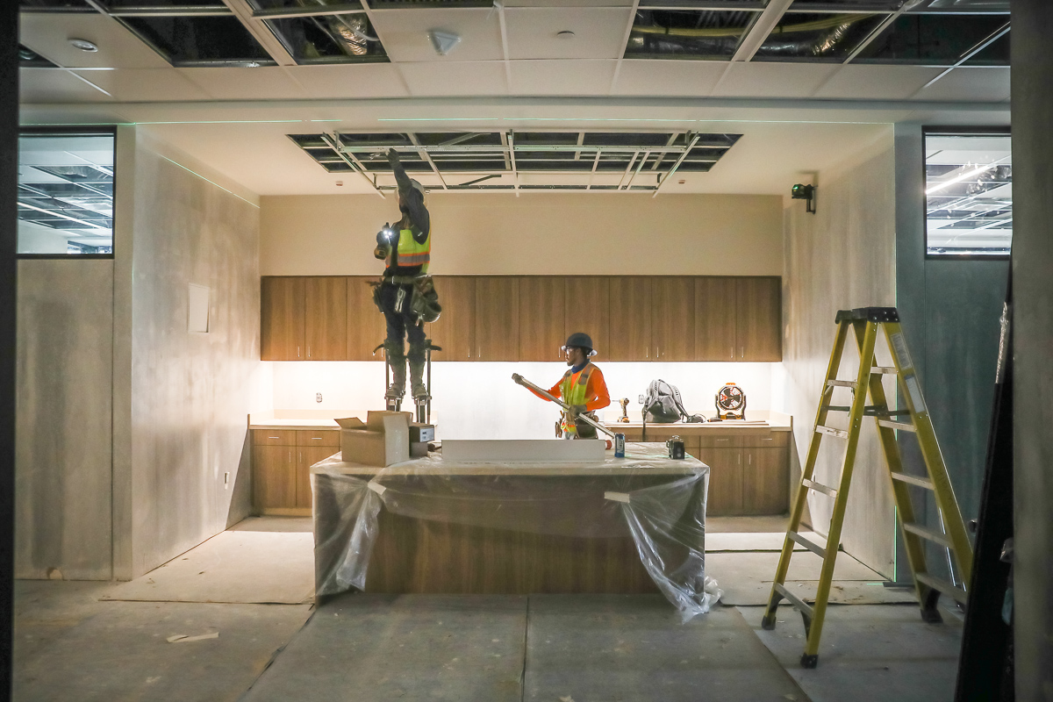
Interior doors have been hung in Area C. Mailroom and work stations are progressing in Area B and C.

Slide 4
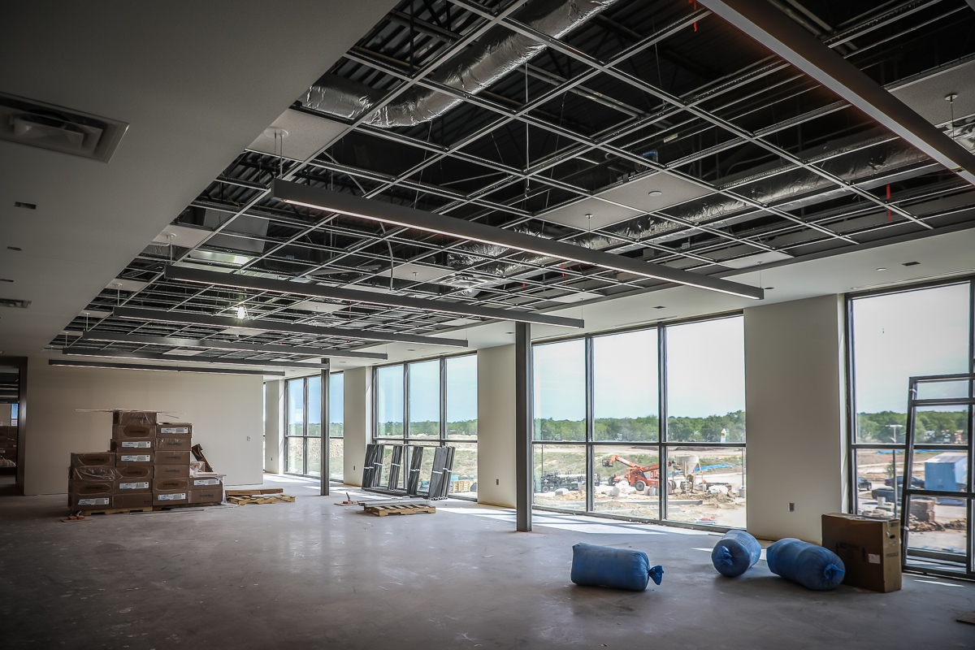
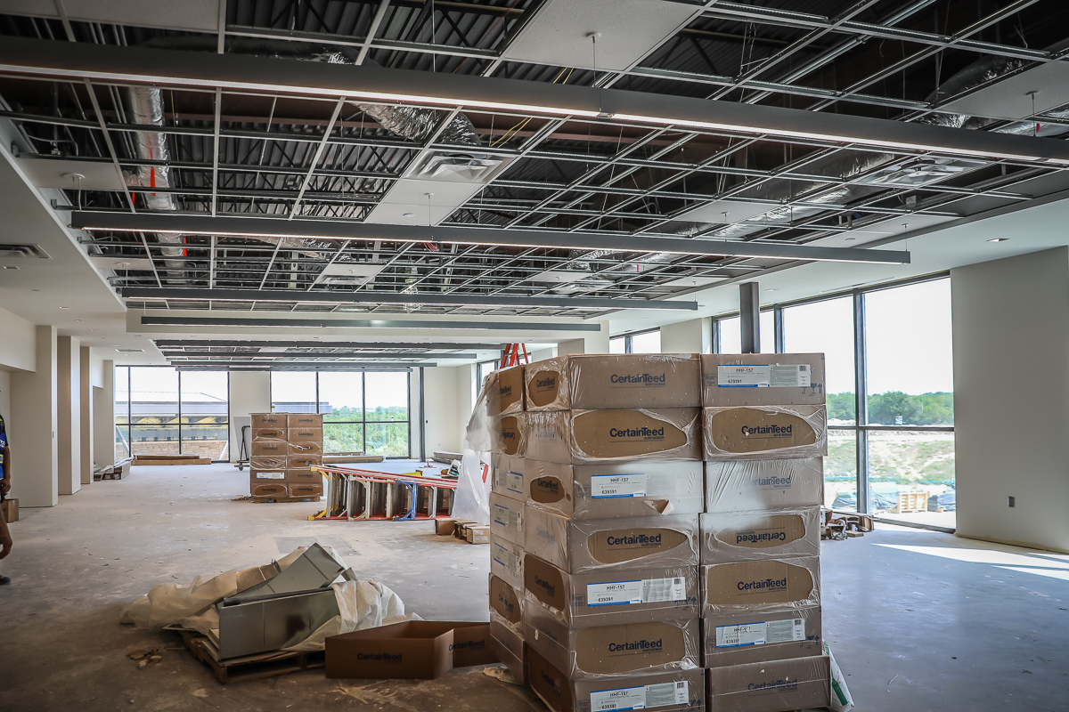
Upper level Area B millwork installation, data, and lighting are in progress.

Slide 5
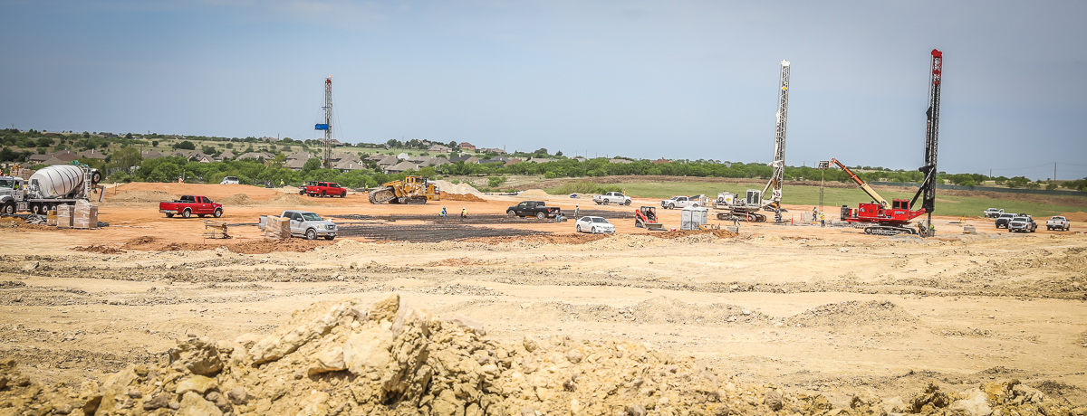
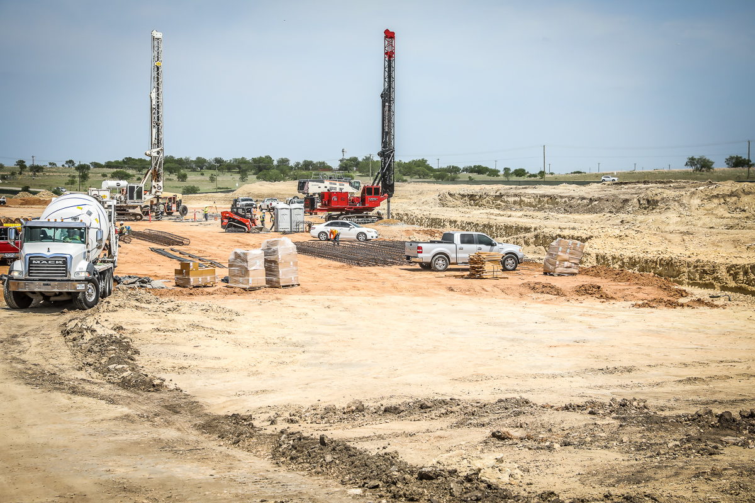
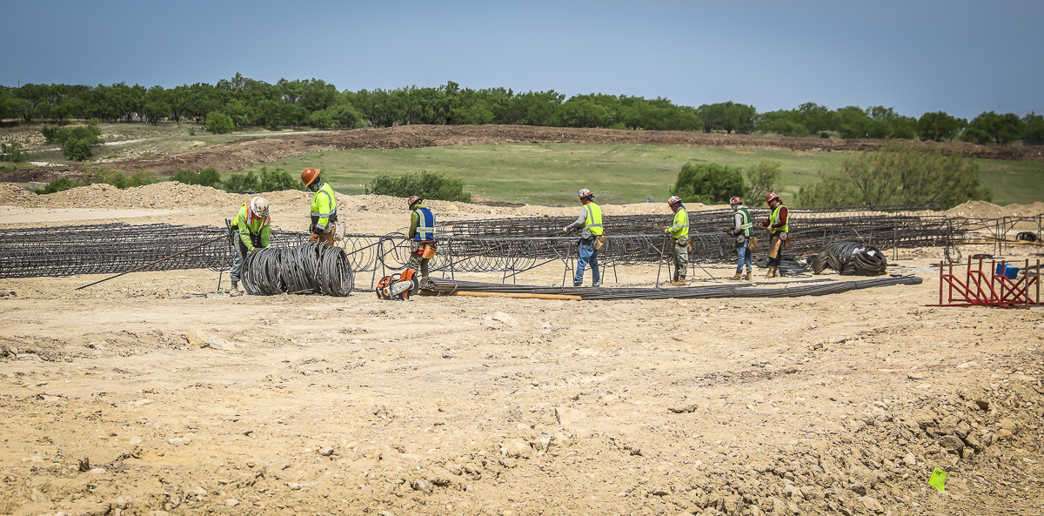
EAGLE MOUNTAIN HS
Building pad for the cafeteria, fine arts, and gymnasiums is complete. Pier construction is ongoing.

